Slide 1
Distributed System Structures
Dr. Muazzam A. Khan

Slide 2
What Is An Operating System
A modern computer consists of:
One or more processors
Main memory
Disks
Printers
Various input/output devices
Managing all these components requires a layer of software – the operating system
Notes:
A modern computer is a complex system. It’s impossible for every application programmer to understand how all these thing work in detail. Furthermore, managing all these components and using them optimally is an exceedingly challenging job.
therefore, OS is introduced to provide user programs with a better, simpler, cleaner model of the computer and handle all the resources.
User uses various kinds of OS.

Slide 3
What is an Operating System?
A modern computer is very complex.
  Networking
  Disks
  Video/audio card
  ….
It is impossible for every application programmer to understand every detail
A layer of computer software is introduced to provide a better, simpler, cleaner model of the resources and manage them

Slide 4
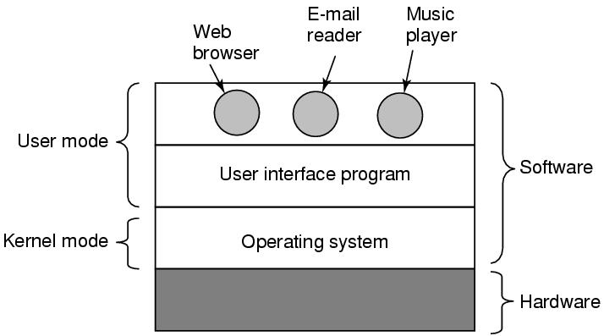
What Is An Operating System
Figure 1-1. Where the operating system fits in.

Slide 5
What is an Operating System?
On top of hardware is OS
Most computers have two modes of operation:
  Kernel mode and user mode
  OS runs in kernel mode, which has complete access to all hardware and can execute any instruction
  Rest of software runs in user mode, which has limited capability.

Slide 6
As an extended machine
Abstraction:
  CPU—process
  Storage –- files
  Memory– address space
4 types of people:
  Industrial engineer: design hardware
  Kernel designer
  Application programmer: OS’s user
  End users

Slide 7
The Operating System as a Resource Manager
Allow multiple programs to run at the same time
Manage and protect memory, I/O devices, and other resources
Includes multiplexing (sharing) resources in two different ways:
  In time
  In space

Slide 8
As a resource manager
Modern OS runs multiple programs of multiple users at the same time
  Imagine what would happen if several programs want to print at the same time?
  How to account the resource usage of each process?
  Resources can be multiplexed:
    How to ensure fairness and efficiency?

Slide 9
summary
Operating system is a software
  Is a complex software
  Runs in kernel mode
  Manages hardware
  Provide a friendly interface for application programmer

Slide 10
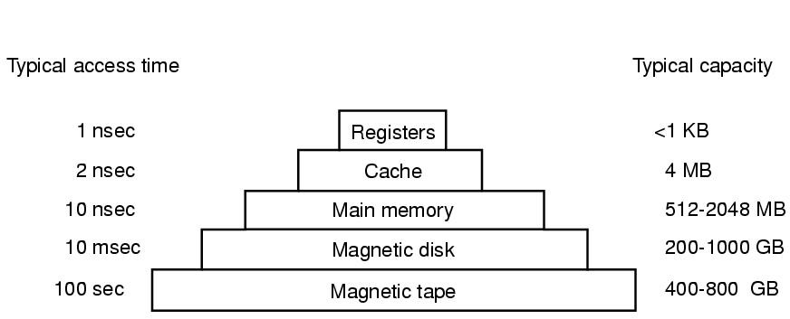
Memory
Figure 1-9. A typical memory hierarchy.
The numbers are very rough approximations.

Slide 11
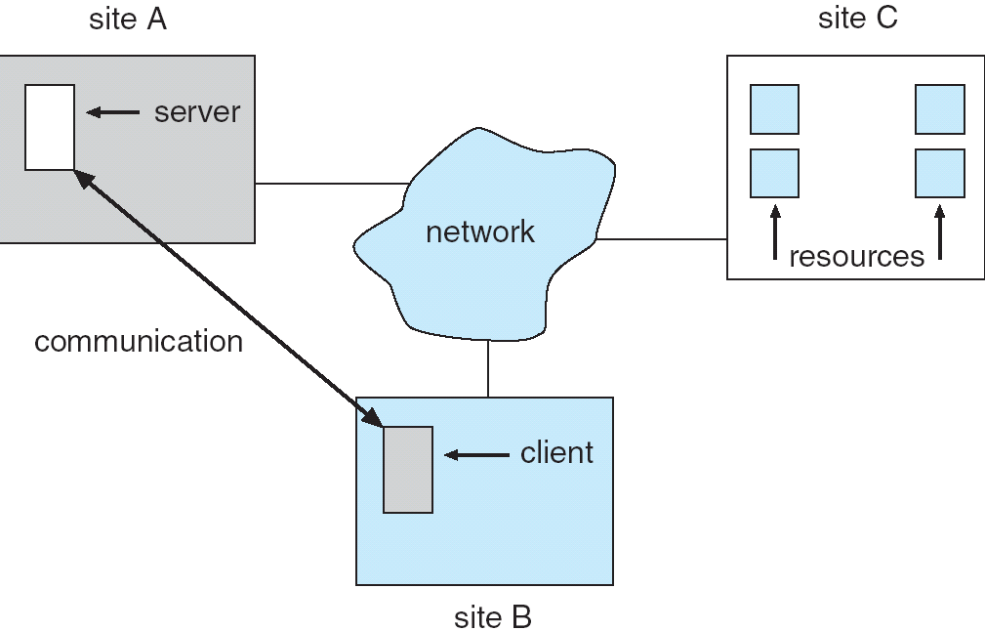
Distributed Systems
Distributed system is collection of loosely coupled processors interconnected by a communications network
Processors variously called nodes, computers, machines, hosts
Site is the location of the processor
Host refers to a specific system at a site
One host at one site, the client, requests a resource from another site, the server

Slide 12
Motivation
Reasons for distributed systems:
  Resource sharing
    Sharing and printing files at remote sites
    Processing information in a distributed database
    Using remote specialized hardware devices
    Using specialized software at remote site
  Computation speedup – load sharing by moving jobs to lightly loaded sites
  Reliability – detect and recover from site failure, function transfer, reintegrate failed site
  Communication – message passing
    File transfer, login, mail, and RPC

Slide 13
Types of Distributed Operating Systems
Two types of distributed operating systems:
  Network Operating Systems
  Distributed Operating Systems

Slide 14
Network-Operating Systems
Users are aware of multiplicity of machines, transparent and more difficult to use
Access to resources of various machines is done explicitly by:
  Remote logging into the appropriate remote machine (telnet, ssh)
  Remote Desktop
  Transferring data from remote machines to local machines, via the File Transfer Protocol (FTP) mechanism
    Requires explicit FTP commands: get, put…

Slide 15
Distributed-Operating Systems
Users not aware of multiplicity of machines: access to remote resources similar to access to local resources
Data Migration – transfer data by transferring entire file, or transferring only those portions of the file necessary for the immediate task
  Old version of Andrew file system moves entire file to local site (automated FTP)
  NFS only moves parts that are needed
Computation Migration – transfer the computation, rather than the data, across the system
  If it takes longer to transfer the data than it is to execute the command, then migrate operation
    Database queries

Slide 16
Distributed-Operating Systems (Cont.)
Process Migration – execute an entire process, or parts of it, at different sites
  Load balancing – distribute processes across network to even the workload
  Computation speedup – subprocesses can run concurrently on different sites
  Hardware preference – process execution may require specialized processor
  Software preference – required software may be available at only a particular site
  Data access – run process remotely, rather than transfer all data locally

Slide 17
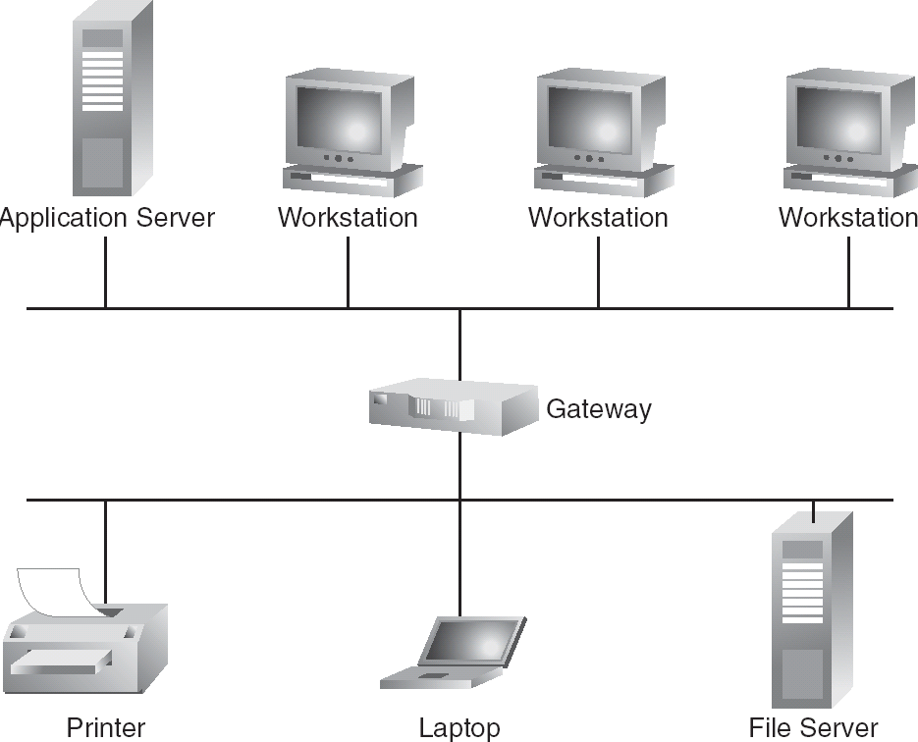
Network Structure
Local-Area Network (LAN) – designed to cover small geographical area
  Nodes are terminals, workstations, PCs, printers, NFS, and/or a few (one or two) mainframes

Slide 18
Network Structure (Cont.)
Local-Area Network (LAN)
  Topology: multiaccess bus, ring, or star network
  Broadcast is fast and cheap
  Speed ≈ 10 – 100 megabits/second
    10BaseT Ethernet (10 megabits/sec)
    100BaseT Ethernet (100 megabits/sec)
    FDDI token network (100 megabits/sec)

Slide 19
Network Structure (Cont.)
Wide-Area Network (WAN) – links geographically separated sites
  Point-to-point connections over long-haul lines (often leased from a phone company)
  Arpanet (1968) grew to become Internet
    Telephone lines, microwave links, satellite channels, fiber optic
  Nodes:
    Mostly mainframes and communication processors (CPs) and routers to link regional networks
  Broadcast usually requires multiple messages
  Speed ≈ 1.544 – 45 megabits/second

Slide 20
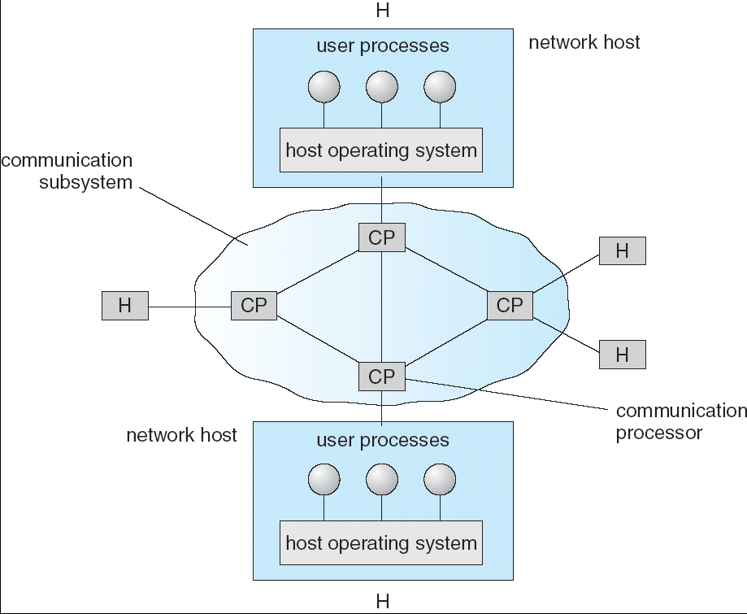
Communication Processors in a Wide-Area Network

Slide 21
Network Topology
Sites in the system can be physically connected in a variety of ways; they are compared with respect to the following criteria:
  Basic cost - How expensive is it to link the various sites in the system?
  Communication cost - How long does it take to send a message from site A to site B?
  Reliability - If a link or a site in the system fails, can the remaining sites still communicate with each other?
The various topologies are depicted as graphs whose nodes correspond to sites
  An edge from node A to node B corresponds to a direct connection between the two sites

Slide 22
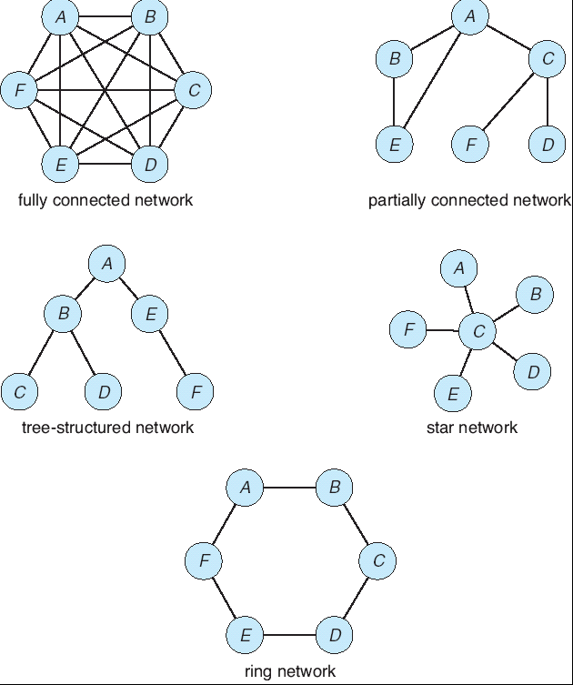
Network Topology

Slide 23
Communication Structure
The design of a communication network must address four basic issues:
Naming and name resolution - How do two processes locate each other to communicate?
Routing strategies - How are messages sent through the network?
Connection strategies - How do two processes send a sequence of messages?
Contention - The network is a shared resource, so how do we resolve conflicting demands for its use?

Slide 24
Naming and Name Resolution
Name systems in the network
Address messages with the process-id
Identify processes on remote systems by
      <host-name, identifier> pair
Domain name service (DNS) – specifies the naming structure of the hosts, as well as resolves a name to an address (Internet)
Name server takes a domain name and returns the name server responsible for the lower-level domain part
Top-level domains .edu, .com, .org
  fsu.edu
    cs.fsu.edu
      program1.cs.fsu.edu → IP address

Slide 25
Routing Strategies
Fixed routing - A path from A to B is specified in advance; path changes only if a hardware failure disables it
  Since the shortest path is usually chosen, communication costs are minimized
  Fixed routing cannot adapt to load changes
  Ensures that messages will be delivered in the order in which they were sent
Virtual circuit - A path from A to B is fixed for the duration of one session. Different sessions involving messages from A to B may have different paths
  Ensures that messages will be delivered in the order in which they were sent

Slide 26
Routing Strategies (Cont.)
Dynamic routing - The path used to send a message form site A to site B is chosen only when a message is sent
  Usually a site sends a message to another site on the link least used at that particular time
  Adapts to load changes by avoiding routing messages on heavily used path
  Messages may arrive out of order
    This problem can be remedied by appending a sequence number to each message

Slide 27
Connection Strategies
Circuit switching - A permanent physical link is established for the duration of the communication (i.e., telephone system)
Message switching - A temporary link is established for the duration of one message transfer (i.e., post-office mailing system)
Packet switching - Messages of variable length are divided into fixed-length packets which are sent to the destination
  Each packet may take a different path through the network
  The packets must be reassembled into messages as they arrive
Circuit switching requires setup time, but incurs less overhead for shipping each message, and may waste network bandwidth
  Message and packet switching incur more overhead per message.

Slide 28
Contention
Several sites may want to transmit information over a link simultaneously
To avoid repeated collisions:
  CSMA/CD - Carrier sense with multiple access (CSMA); collision detection (CD)
    A site determines whether another message is currently being transmitted over that link
    If two or more sites begin transmitting at exactly the same time, then they will register a CD and will stop transmitting
    When the system is very busy, many collisions may occur, and thus performance may be degraded
  CSMA/CD is used successfully in the Ethernet system

Slide 29
Contention (Cont.)
Token passing - A token continuously circulates in the system (usually a ring structure)
  A site that wants to transmit information must wait until the token arrives
  When the site completes its round of message passing, it retransmits the token
Message slots - A number of fixed-length message slots continuously circulate in the system (usually a ring structure)
  Since a slot can contain only fixed-sized messages, a single logical message may have to be broken down into a number of smaller packets, each of which is sent in a separate slot

Slide 30
Communication Protocol
The communication network is partitioned into the following multiple layers:
Physical layer – handles the mechanical and electrical details of the physical transmission of a bit stream
Data-link layer – handles the frames, or fixed-length parts of packets, including any error detection and recovery that occurred in the physical layer
Network layer – provides connections and routes packets in the communication network, including handling the address of outgoing packets, decoding the address of incoming packets, and maintaining routing information for proper response to changing load levels

Slide 31
Communication Protocol (Cont.)
Transport layer – responsible for low-level network access and for message transfer between clients, including partitioning messages into packets, maintaining packet order, controlling flow, and generating physical addresses
Session layer – implements sessions, or process-to-process communications protocols
Presentation layer – resolves the differences in formats among the various sites in the network, including character conversions, and half duplex/full duplex (echoing)
Application layer – interacts directly with the users’ deals with file transfer, remote-login protocols and electronic mail, as well as schemas for distributed databases

Slide 32
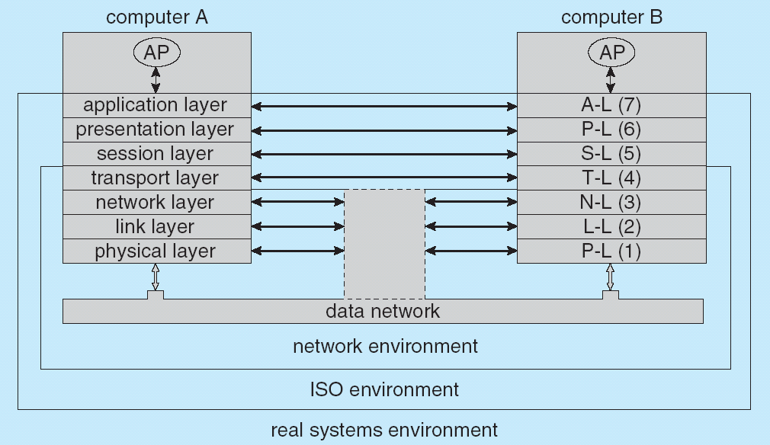
Communication Via ISO Network Model

Slide 33
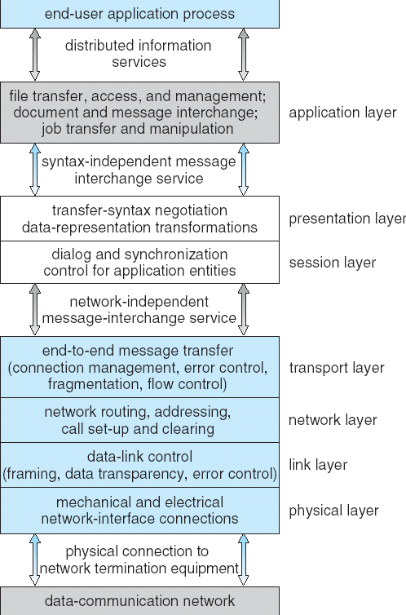
The ISO Protocol Layer

Slide 34
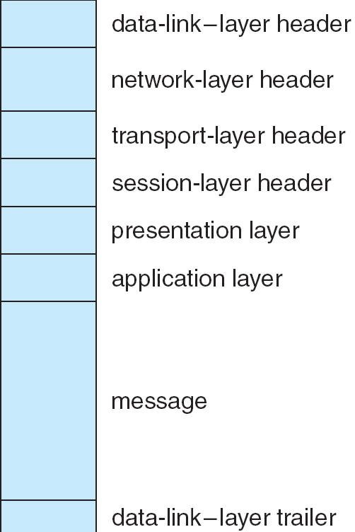
The ISO Network Message

Slide 35
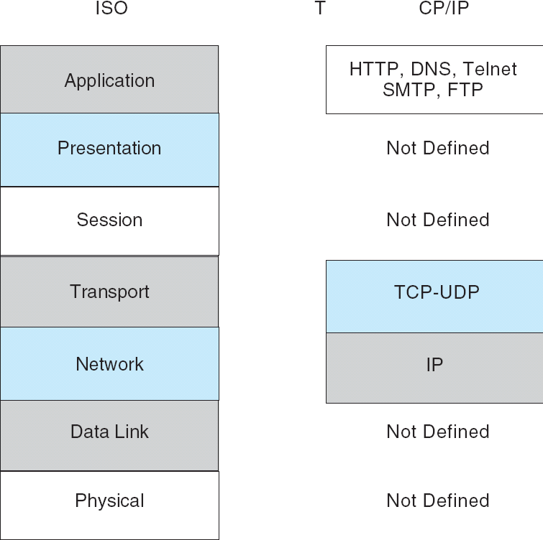
The TCP/IP Protocol Layers

Slide 36
Failure Detection
Detecting hardware failure is difficult
To detect a link failure, a handshaking protocol can be used
Assume site A and site B have established a link
  At fixed intervals, each site will exchange an I-am-up message indicating that they are up and running
If site A does not receive a message within the fixed interval, it assumes either
  The other site is not up
  or the message was lost
Site A can now send an Are-you-up? message to site B
If site A does not receive a reply, it can repeat the message or try an alternate route to site B

Slide 37
Failure Detection (cont)
If site A does not ultimately receive a reply from site B, it concludes some type of failure has occurred
  Types of failures:
    Site B is down
    The direct link between A and B is down
    The alternate link from A to B is down
    The message has been lost
However, site A cannot determine exactly why the failure has occurred

Slide 38
Robustness: Reconfiguration
When site A determines a failure has occurred, it must reconfigure the system:
  If the link from A to B has failed, this must be broadcast to every site in the system
  If a site has failed, every other site must also be notified indicating that the services offered by the failed site are no longer available
When the link or the site becomes available again, this information must again be broadcast to all other sites

Slide 39
Design Issues in Distributed Systems
Transparency – the distributed system should appear as a conventional, centralized system to the user
Fault tolerance – the distributed system should continue to function in the face of failure
Scalability – as demands increase, the system should easily accept the addition of new resources to accommodate the increased demand
Clusters – a collection of semi-autonomous machines that acts as a single system

Slide 40
End of Chapter

